Slide 1

NIRF - A Wakeup Call To Higher Educational Institutions
Presented By
Dr. S. V. Kota Reddy
Vice Chancellor, VIT-AP University

Slide 2
Introduction
National Institutional Ranking Framework (NIRF) is an initiative of the Ministry of Human Resource Development (MHRD) to rank higher education institutions across India. The Framework was approved by the MHRD and launched on 29 September 2015. The NIRF is a framework, introduced in 2016, to objectively compare institutions on parameters such as teaching performance, research output, diversity, and reputation
The NIRF aims to
Identify and recognize top performing institutions
Promote competitiveness among institutions
Assist prospective students in their decision-making process when selecting institutions.

Slide 3
NIRF India Rankings 2016-2020
Year | Categories | Participated Institutions (Overall) | Top Rankings (Overall)
2016 | Universities , Engineering , Management Pharmacy | --- | IISc Bangalore ICT Mumbai JNU, New Delhi
2017 | Overall, Engineering, Management, Universities, College, Pharmacy | 1007 | IISc Bangalore IIT Madras IIT Bombay
2018 | Overall, Universities, Engineering, Colleges, Management, Pharmacy, Medical, Architecture, Law | 957 | IISc Bengaluru IIT Madras, Chennai IIT Bombay
Ref: https://www.nirfindia.org/Home

Slide 4
NIRF India Rankings 2016-2020
Year | Categories | Participated Institutions (Overall) | Top Rankings (Overall)
2019 | Overall, Universities, Engineering, Colleges, Management, Pharmacy, Medical, Architecture, Law | 1479 | IIT Madras, Chennai IISc Bengaluru IIT Delhi
2020 | Overall, Engineering, Management, Universities, College, Pharmacy, Dental | 1667 | IISc Bangalore IIT Madras, Chennai IIT Bombay
Note: There is discipline wise methodology
Ref: https://www.nirfindia.org/Home

Slide 5
NIRF India Rankings for 2021
India Rankings introduces a new Category “Research Institutions” Eligibility Criteria for Institutes => At least 500 Research publications indexed in Web of Science/ Scopus for a period of 3 years OR
=> At least 1000 students enrolled in Ph.D. program.
Ref: https://www.nirfindia.org/Home

Slide 6
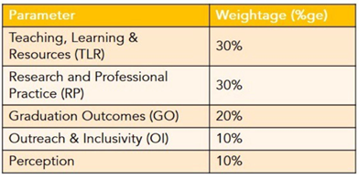
NIRF India Rankings ( Parameters and weightage )
Ref: https://www.nirfindia.org/Home

Slide 7
NIRF India Rankings ( Parameters )
Teaching, Learning & Resources (TLR)
Student Strength including Doctoral Students (SS) Faculty-student ratio with emphasis on permanent faculty (FSR) Combined metric for Faculty with PhD (or equivalent) and Experience (FQE) Financial Resources and their Utilisation (FRU)
Research and Professional Practice (RP)
Combined metric for Publications (PU) Combined metric for Quality of Publications (QP) IPR and Patents: Published and Granted (IPR) Footprint of Projects and Professional Practice (FPPP)
Ref: https://www.nirfindia.org/Home

Slide 8
NIRF India Rankings ( Parameters )
Graduation Outcomes (GO)
Metric for University Examinations (GUE) Metric for Number of Ph.D. Students Graduated (GPHD)
Outreach and Inclusivity (OI)
Percentage of Students from Other States/Countries (Region Diversity RD) Percentage of Women (Women Diversity WD) Economically and Socially Challenged Students (ESCS) Facilities for Physically Challenged Students (PCS) Perception (PR) Ranking
Perception
Academic Peers and Employers (PR)
Ref: https://www.nirfindia.org/Home

Slide 9
NIRF : Share of ranks by Institution type (2020)
Out of ranked institutions:
Private Deemed universities and affiliated colleges : 23% each Institutes of National Importance (INI): 21% Categories seeing domination: Deemed Private University : University (37%), Medical(38%), Dental (53%) Affiliated Colleges: Engineering (38%), Pharmacy(37%) Central Universities: Architecture (60%),Management (33%) In University Category representative of private institutions in top 100 is increased to 40 from 28 in 2019
Ref: Report Published by KPMG, NIRF (2020) Category-specific analysis, June (2020)

Slide 10
NIRF : Categories and Participation in 2020
Ref: Report Published by KPMG, NIRF (2020) Category-specific analysis, June (2020)

Slide 11
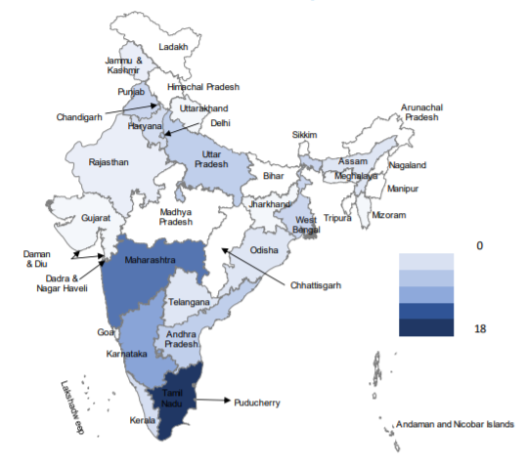
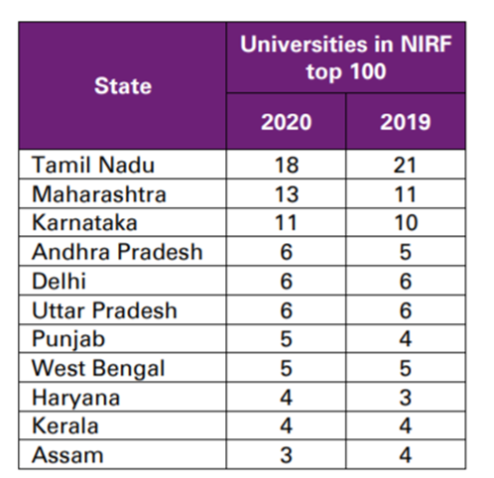
State-wise distribution of top 100 ranked universities
Ref: Report Published by KPMG, NIRF (2020) Category-specific analysis, June (2020)

Slide 12
Types of institutions dominating NIRF Ranking – by age
Older Institutions fared better in rankings
62% of universities among top 100 are between 1950 and 2000. 48% of private universities among top 100 are between 1980 and 2000 One university established in last decade is in top 100 ranked universities.
Ref: Report Published by KPMG, NIRF (2020) Category-specific analysis, June (2020)

Slide 13
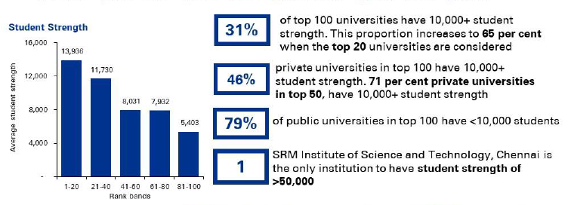
NIRF Ranking and Students Strength
Ref: Report Published by KPMG, NIRF (2020) Category-specific analysis, June (2020)

Slide 14

Institutes/ Universities to offer High Quality Education
ADVANTAGES
OF NIRF
RANKING
National ranking system will help students to choose the best university.
A national ranking ensures that all higher educational institutes strive hard to improve their rankings.
Indian Universities can compete in Global Rankings

Slide 15
Global Rankings
Major International Rankings
The QS World University Rankings : Ranking of the world's top universities by Quacquarelli Symonds published annually since 2004 Times Higher Education World Reputation Rankings: Published for the first time in March 2011. The rankings are based on a survey of (for 2016) 10,323 academics from 133 countries. Academic Ranking of World Universities : Compiled originally by the Shanghai Jiao Tong University and now maintained by the Shanghai Ranking Consultancy, since 2003

Slide 16
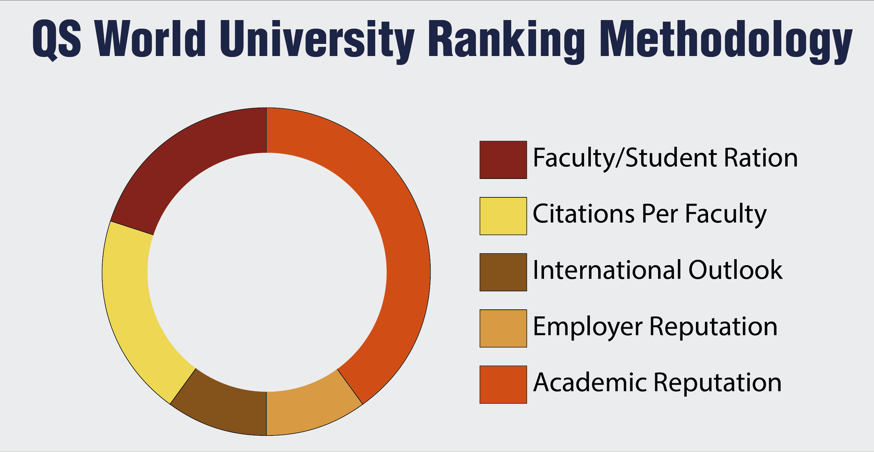
‘QS World University’ Rankings Methodology
QS Methodology
Academic Reputation (40%) Employer Reputation (10%) Faculty Student Ratio (20%) Citations per faculty (20%) International faculty ratio/International student ratio (5% each)
Ref: www.topuniversities.com

Slide 17
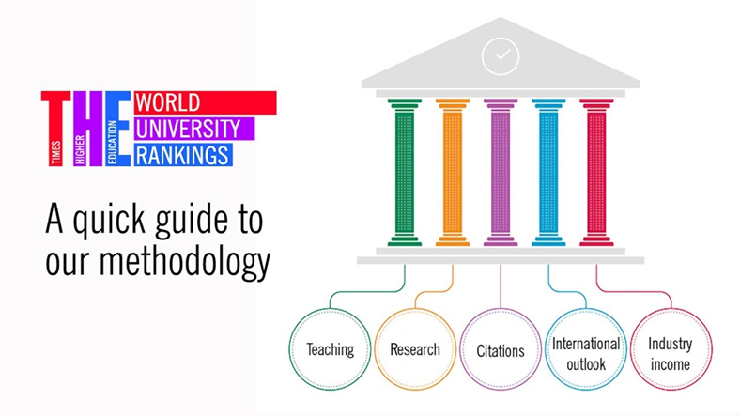
Times Higher Education World University Rankings
Ref: www.timeshighereducation.com

Slide 18
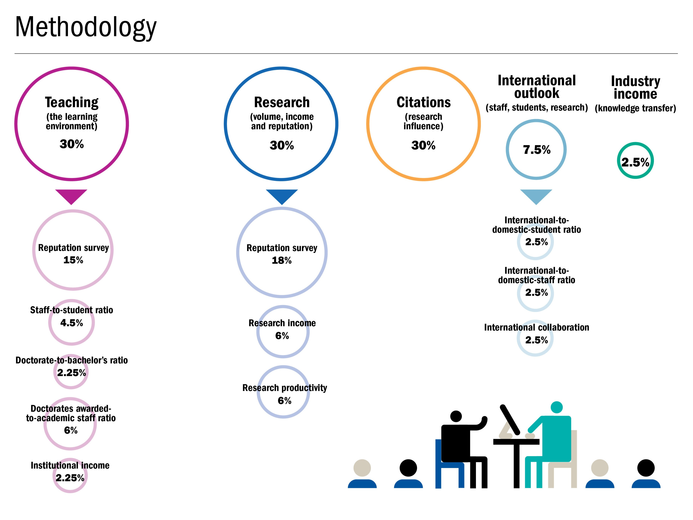
‘THE World University Rankings’ Methodology :
Ref : https://www.timeshighereducation.com/cn/student/advice/world-university-rankings-explained

Slide 19
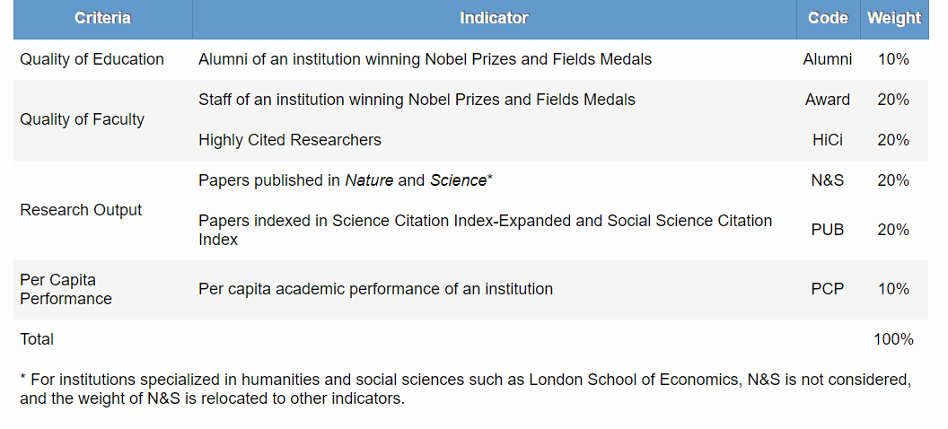
‘Academic Ranking of World Universities’ Methodology
Ref : http://www.shanghairanking.com/ARWU-Methodology-2020.html#2

Slide 20
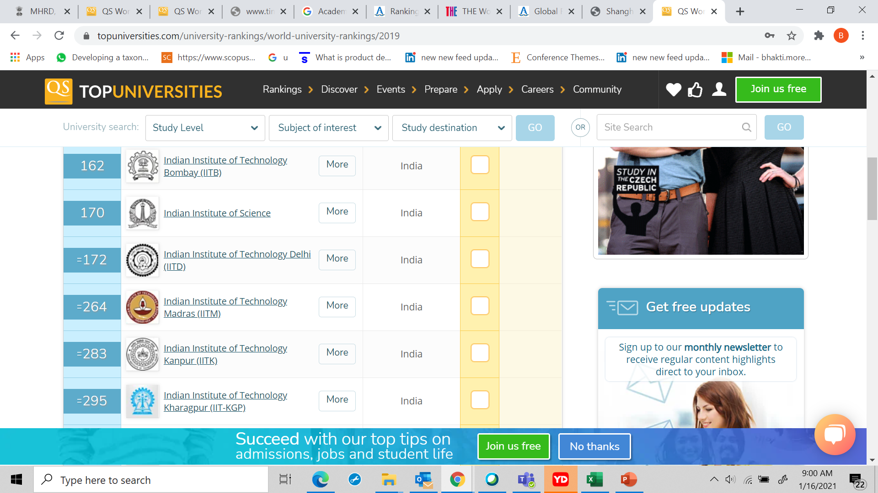
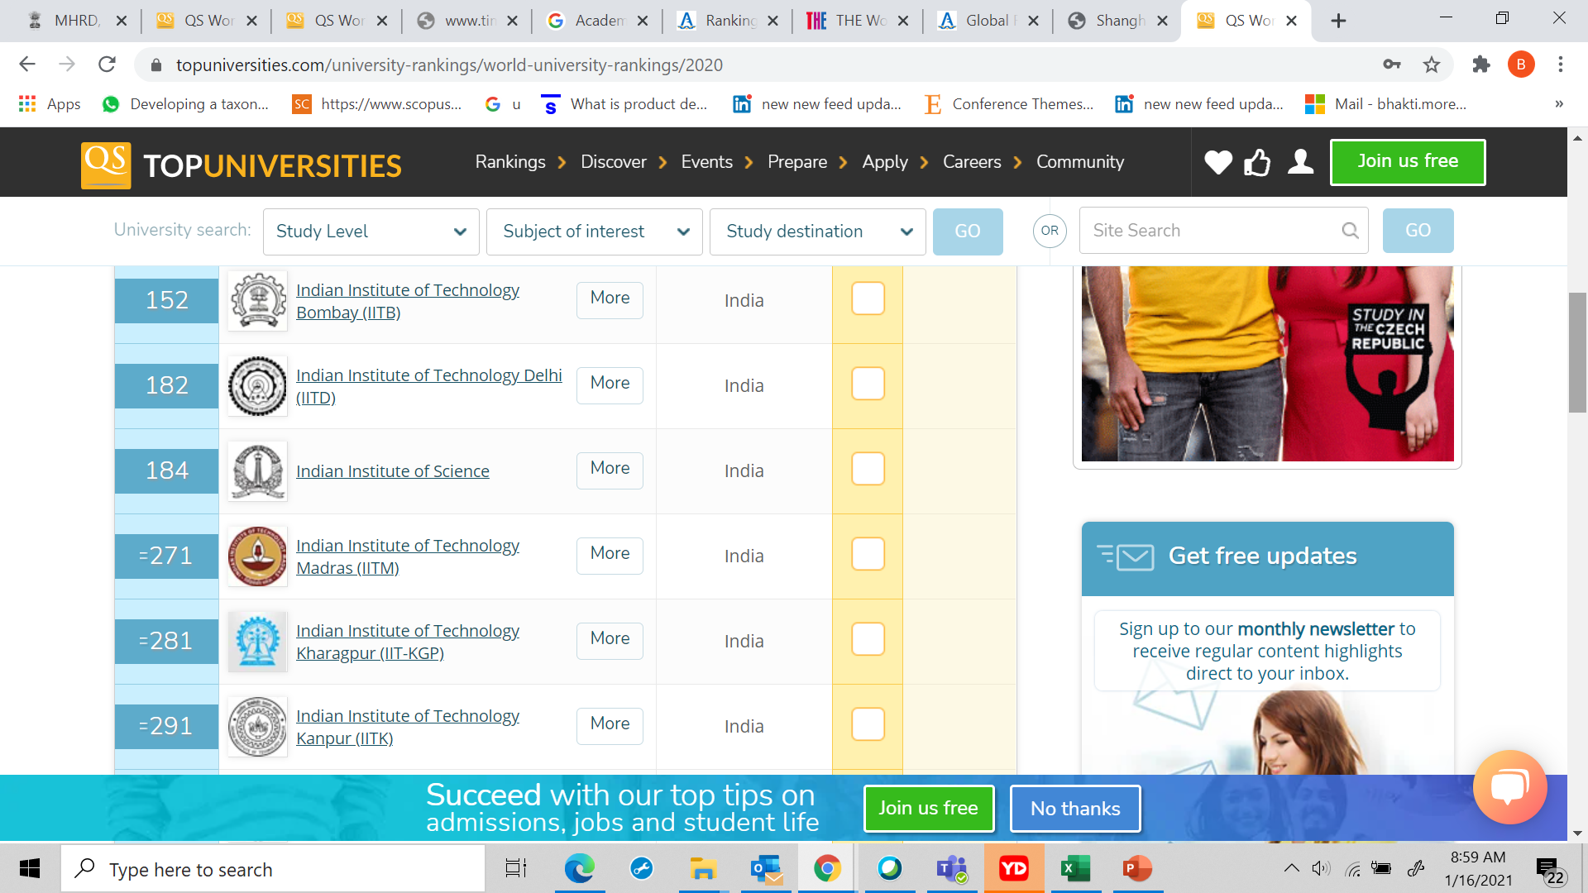
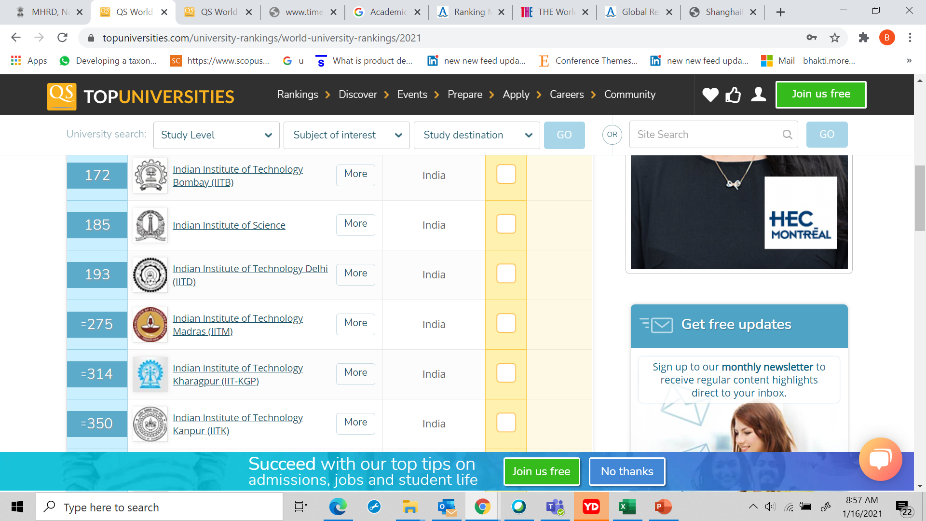
‘QS World University Ranking’
QS 2019
QS 2020
QS 2021
Ref: https://www.topuniversities.com/qs-world-university-rankings

Slide 21
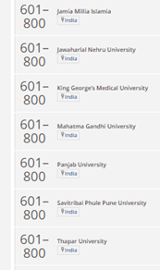
‘THE World University Ranking 2021’ Indian Universities
301 – 350
Indian Institute of Science
601 - 800
Banaras Hindu University Institute of Chemical Technology University of Delhi Indian Institute of Science, Education and Research, Pune Indian Institute of Technology Gandhinagar Indian Institute of Technology Hyderabad Indraprastha Institute of Information Technology, Delhi
351 – 400
Indian Institute of Technology, Ropar
401 – 500
Indian Institute of Technology, Indore
Ref: https://www.timeshighereducation.com/world-university-rankings/2021/worldranking#!/page/0/length/25/locations/IN/sort_by/rank/sort_order/asc/cols/stats

Slide 22
‘THE World University Ranking 2021’ Indian Universities
601 - 800
Jamia Milia Islamia Jawaharlal Nehru University King George Medical University Mahatma Gandhi University Punjab University Savitribai Phule Pune University Thapar University
Ref: https://www.topuniversities.com/qs-world-university-rankings

Slide 23
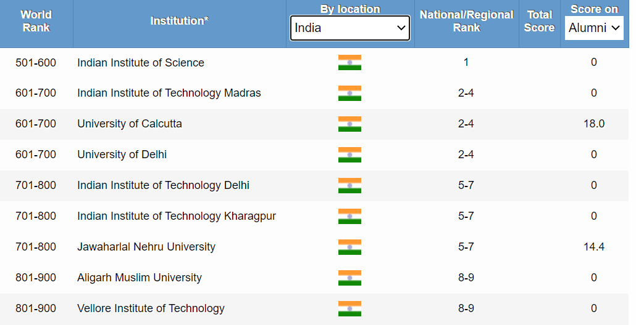
‘Academic Ranking of World Universities 2020’
Ref: http://www.shanghairanking.com/ARWU2020.html

Slide 24
National Education Policy (NEP) 2020
Highlights of NEP 2020
New Curricular and Pedagogical Structure (5+3+3+4); No hard separations between arts and sciences, between curricular and extra-curricular activities, between vocational and academic streams; Equitable and inclusive education - Special emphasis given on Socially and Economically Disadvantaged Groups(SEDGs); Robust and transparent processes for recruitment of teachers and merit-based performance Exposure of vocational education in school and higher education system; Increasing Gross Enrolment Ratio (GER)) in higher education to 50%; Holistic Multidisciplinary Education with multiple entry/exit options;
Ref : https://pib.gov.in/PressReleaseIframePage.aspx?PRID=1654058

Slide 25
National Education Policy (NEP) 2020
Highlights of NEP 2020
NTA to offer Common Entrance Exam for Admission to HEIs Establishment of Academic Bank of Credit Setting up of Multidisciplinary Education and Research Universities(MERUs) Setting up of National Research Foundation(NRF) Single overarching umbrella body for promotion of higher education sector including teacher education and excluding medical and legal education- the Higher Education Commission of India (HECI)-with independent bodies for standard setting- the General Education Council; funding-Higher Education Grants Council (HEGC); accreditation- National Accreditation Council (NAC); and regulation- National Higher Education Regulatory Council (NHERC)
Ref : https://pib.gov.in/PressReleaseIframePage.aspx?PRID=1654058

Slide 26
National Education Policy (NEP) 2020
Highlights of NEP 2020
Stand-alone technical universities, health science universities, legal and agricultural universities, or institutions in these or other fields, will aim to become multi-disciplinary institutions. Creation of National Educational Technology Forum (NETF) to provide a platform for the free exchange of ideas on the use of technology to enhance learning, assessment, planning, administration. Appropriate integration of technology into all levels of education.
Ref : https://pib.gov.in/PressReleaseIframePage.aspx?PRID=1654058

Slide 27
Institutions of Eminence and NIRF
Institutions of Eminence scheme has been launched by the Government to empower the Higher Educational Institutions and to help them become world class teaching and research institutions, as announced by the Hon’ble Finance Minister in his budget speech of 2016.
Ref: Report Published by KPMG, NIRF (2020) Category-specific analysis, June (2020)

Slide 28
NIRF Ranking and Funding
Government Funding based on NIRF Ranking
Funding for educational institutes could soon be linked to the rank they secure in the National Institutional Ranking Framework (NIRF). Ministry of Human Resource Development (MHRD) is looking into a proposal to base the quantum of funds to the rank. This will not only ensure higher participation of institutions but will also play a role in improving their physical infrastructure and academic output.
Ref: https://www.moneycontrol.com/news/business/economy/nirf-ranking-may-soon-determine-funding-for-educational-institutes-4435201.html

Slide 29
NIRF Ranking – A Wake up Call for HEI
HEI and NRF Ranking
Higher Education Institutes can do their own assessments of overall performance on strengths, weakness in every aspect. NIRF ranking can encourage HEI to participate in the Global Rankings. The Parameters of NIRF can assess HEI capacity building for strategies on: Improve faculty student ratio, emphasis on permanent faculty Appointment of faculty with Doctoral Qualification and experience. Implement Outcome based teaching learning Enhance Best teaching-learning practices Enhance Student experience - student satisfaction surveys,

Slide 30
NIRF Ranking – A Wake up Call for HEI
HEI and NRF Ranking
Enhance Research outcomes through publications, citations, patents, innovation, research grants Enhance Collaboration and Partnerships Improve Infrastructural facilities, technology enhancement Enhance perception of the University/Institute Focus on Graduate attributes to enhance employability for employer perception Encourage Diversity and Inclusion

Slide 31


